Slide 1
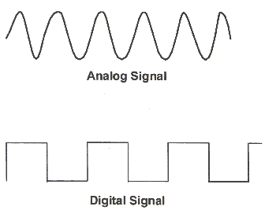
PWM for LED Brightness
Analog signals are continuous – can take on any value
Digital signals are discrete – High or Low for Arduino
I want my LED brightness to change without swapping out resistors
Image: http://www.globalspec.com/learnmore/data_acquisition_signal_conditioning/signal_converting/signal_converters

Slide 2
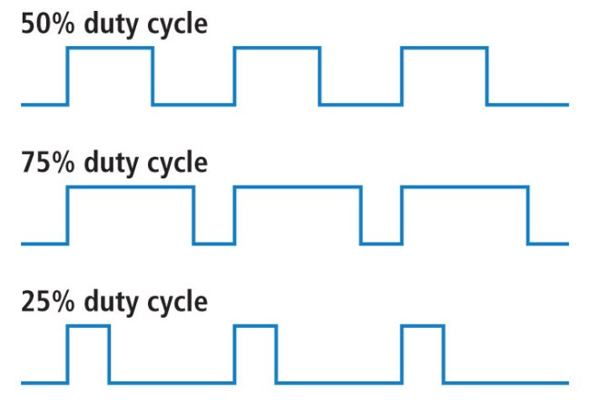
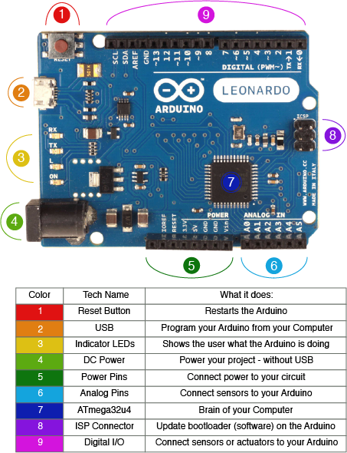
PWM for LED Brightness
Pulse Width Modulation
Provides a value between 0 and 5V
Used for LEDs, motors, and more
Cycle is called the ‘duty cycle’ – specified by % on
You can vary the duty cycle
Arduino PWM frequency is approximately 975 Hz.
1.026 ms
Image: https://learn.sparkfun.com/tutorials/pulse-width-modulation
Image: http://www.keytosmart.com/arduino-leonardo-blinking-led/

Slide 3
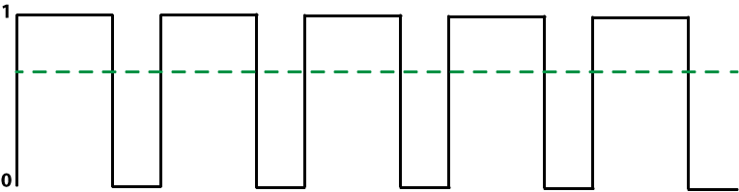
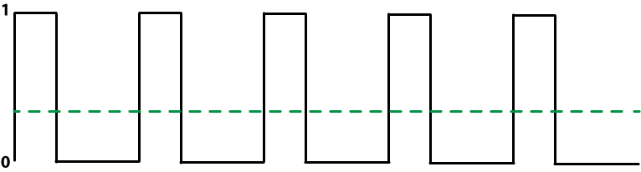
PWM for LED Brightness
Arduino microcontroller is very, very fast
Motors, LEDs, and other components are slower – don’t ‘see’ flickering
Instead, they ‘see’ the average
Images: http://dlnware.com/dll/How-PWM-Works

Slide 4
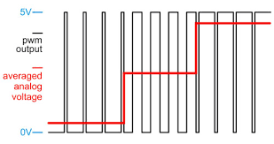
PWM for LED Brightness
In my example I increment the duty cycle in steps
analogWrite(pin, value)
value must be between 0 and 255, maps to 0 to 5V
Brightness increment
Image: https://electronics.stackexchange.com/questions/239442/audio-using-pwm-what-is-the-principle-behind-it
Increment delay
Time of last increment

Slide 5
Example
https://github.com/GeoffSpielman/Hackathin_Examples or search GitHub for ‘Hackathin_Examples’
ledBrightnessIncrement
(ledBrightness)
Image: https://electronics.stackexchange.com/questions/239442/audio-using-pwm-what-is-the-principle-behind-it
LED_INCREMENT_DELAY
lastIncrementTime

Slide 6
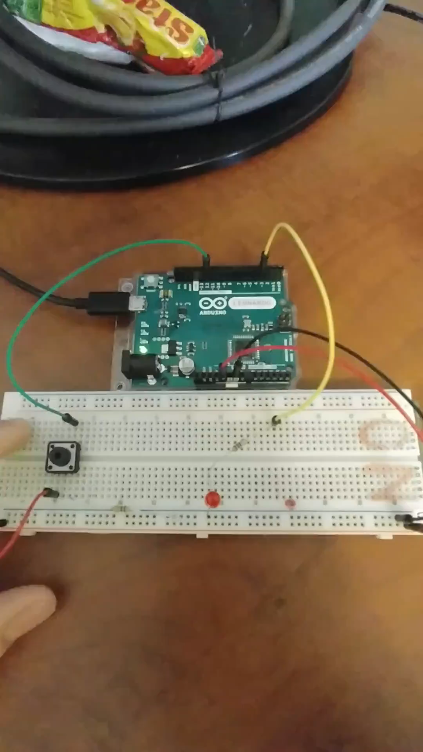
Example

